Slide 1

Number Puzzle Game with Scoreboard
A beginner-friendly C console game featuring random number guessing, attempt tracking, and persistent file-based scoreboard — built with clean modular design.
C PROGRAMMING
FILE I/O
CONSOLE GAME

Slide 2
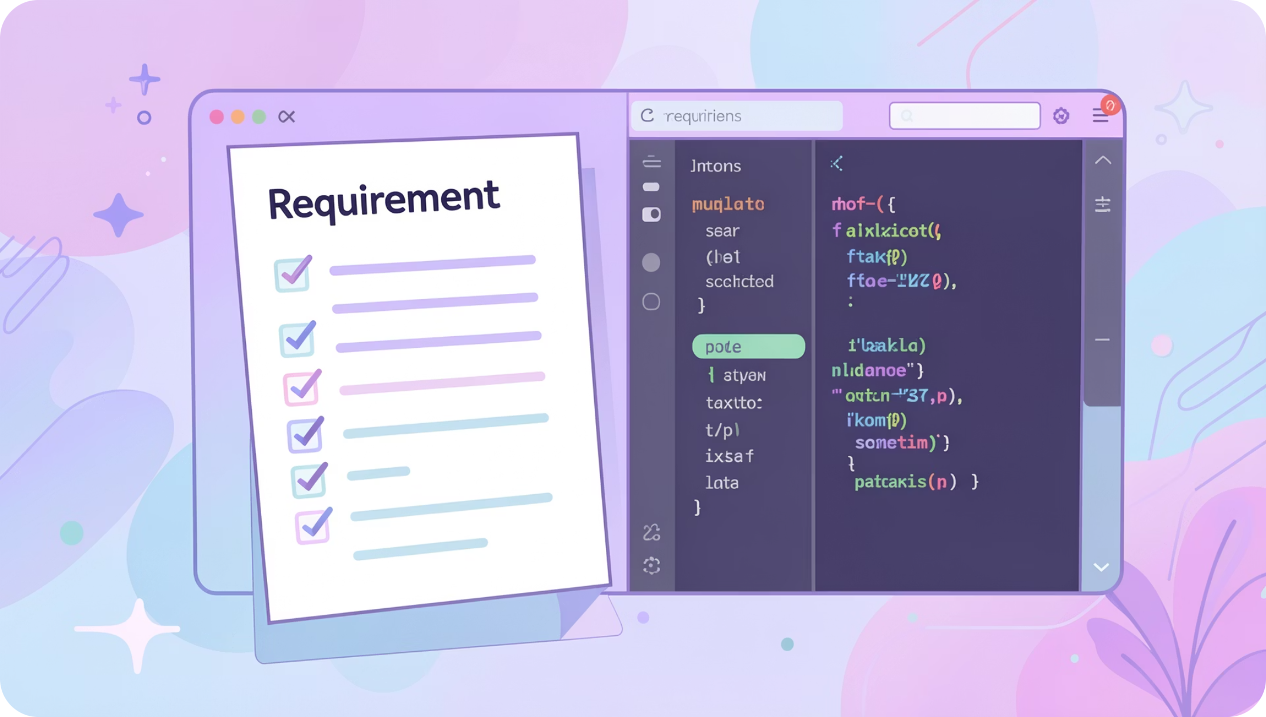
Project Requirements
Functional Requirements
Generate a random number between 1 and 100
Accept and validate player guesses in a loop
Track number of attempts per game session
Save player name and score to a file
Read and display all saved scores
Non-Functional Requirements
Simple text-based console interface
Persistent storage using scores.txt
Error handling for file operations
Modular code with separate functions

Slide 3
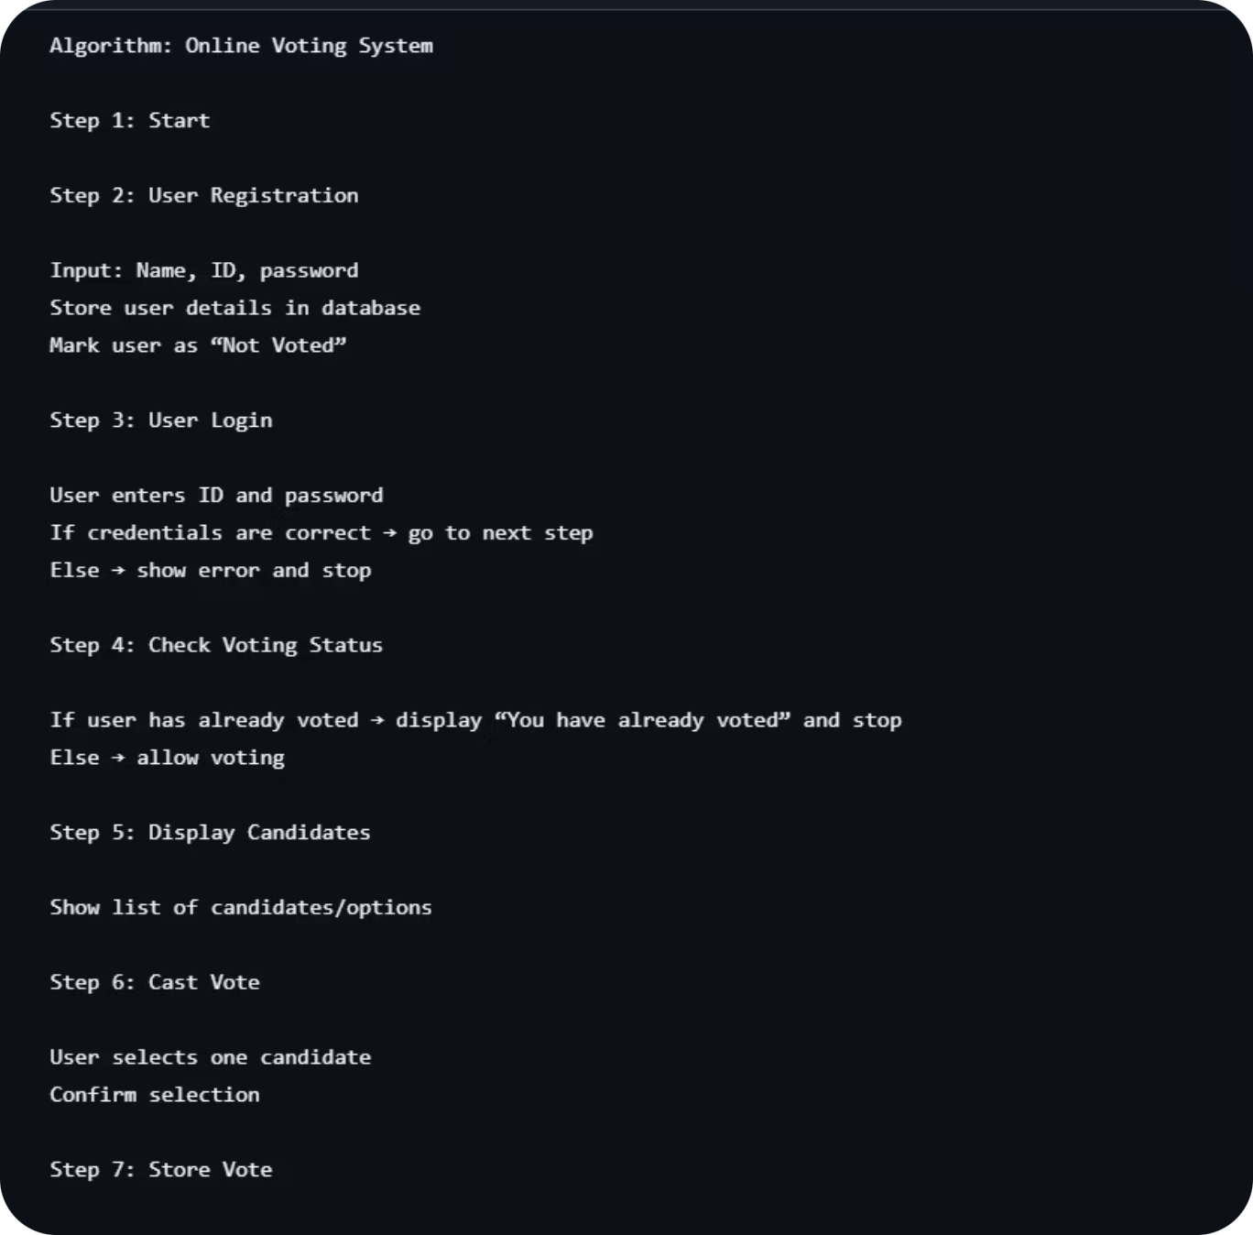
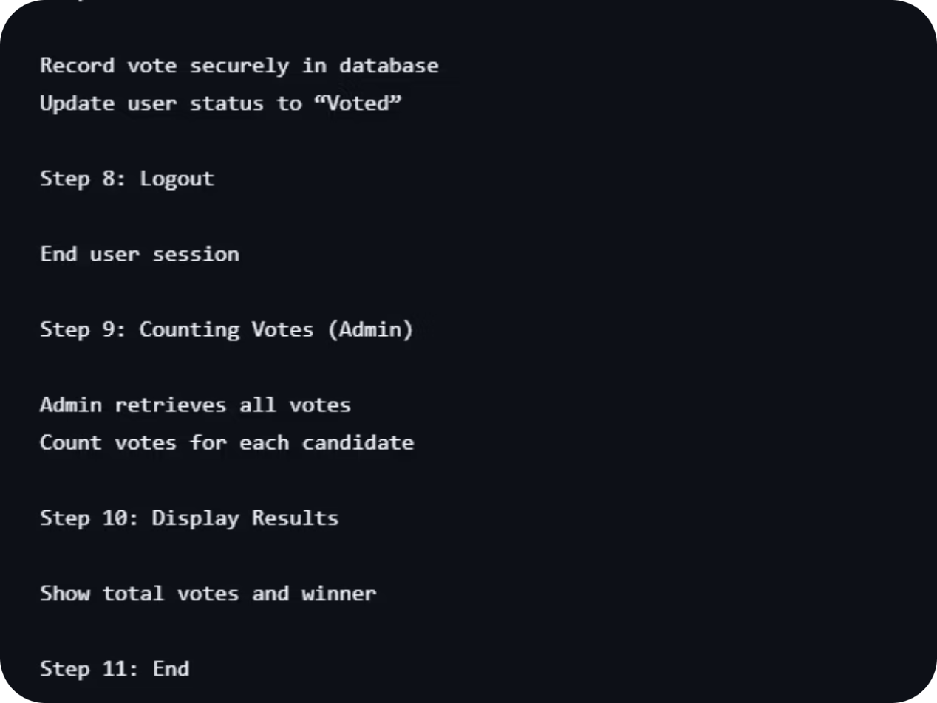
ALGORITHM:

Slide 4
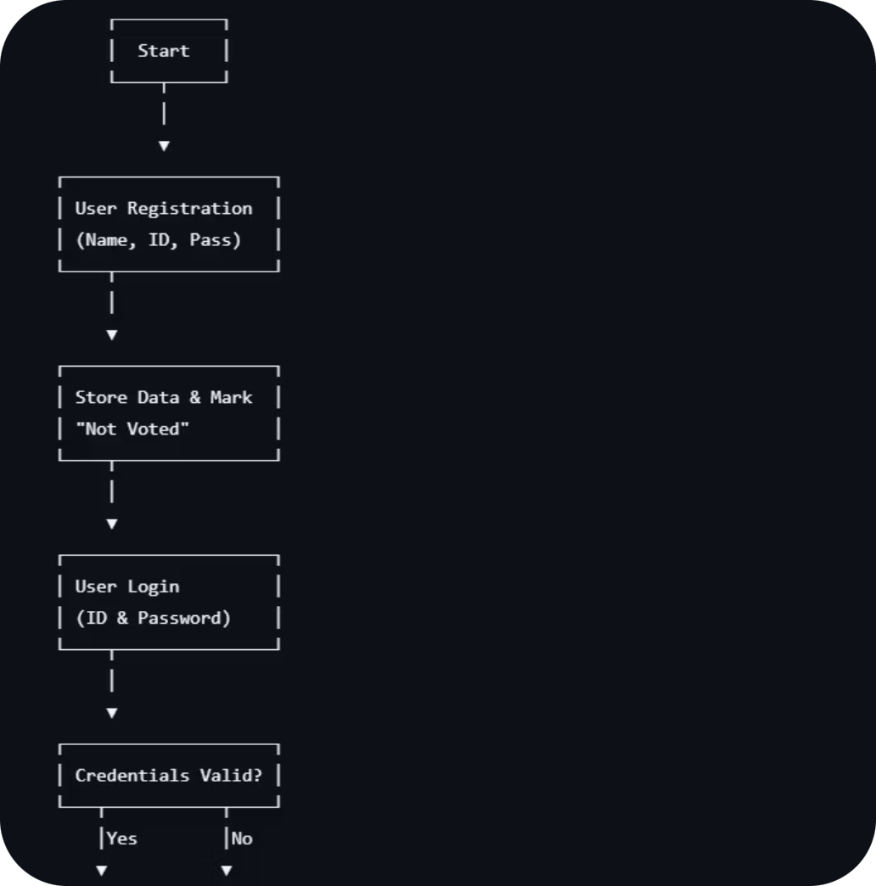
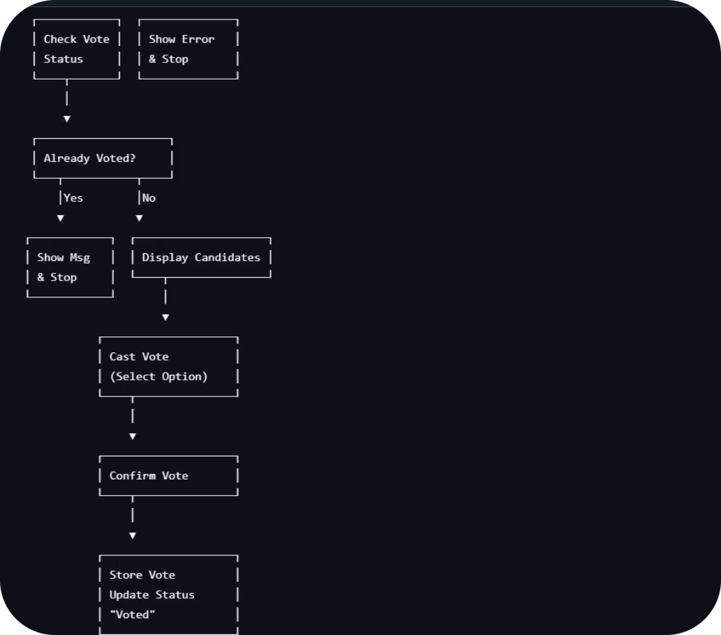
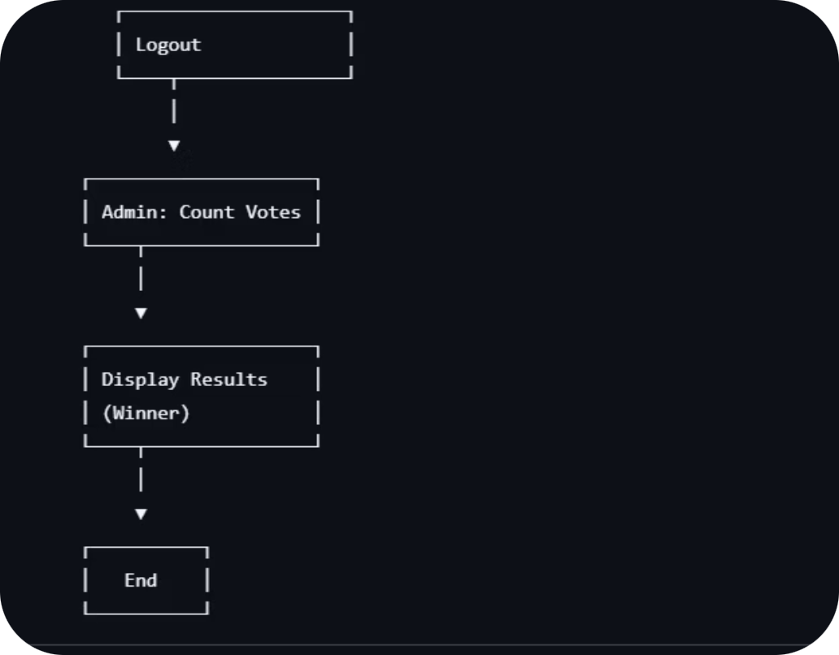
FLOW CHART:

Slide 5
Program Modules
The program is organized into 3 core modules, each handling a distinct responsibility.
Module 1: main()
Module 2: playGame()
Module 3: viewScoreboard()
Displays the main menu in a loop. Routes user input to playGame() or viewScoreboard() using a switch statement.
Handles the full game session — reads player name, generates random number, runs the guess loop, counts attempts, and writes score to file.
Opens scores.txt in read mode and prints all saved player names and attempt counts. Gracefully handles missing file.

Slide 6


Algorithm Complexity & Mathematics
Worst-Case Analysis
In the worst case (random guessing), the player may need up to 100 attempts. With an optimal binary search strategy, the maximum attempts needed is:
This is because each optimal guess eliminates half the remaining search space, following a logarithmic pattern.
Average Case
For random guessing on a uniform distribution over [1, 100], the expected number of attempts is 50. With binary search, the average is approximately ~5.7 attempts.

Slide 7

File I/O: Saving Scores
Scores are appended to scores.txt after every game session using standard C file operations.
01
02
Open File (Append Mode)
Write Record
fopen("scores.txt", "a") — creates the file if it doesn't exist; appends if it does.
fprintf(fp, "%s %d\n", name, attempts) — writes the player name and attempt count as one line.
03
Close & Error Check
fclose(fp) flushes the buffer. If fopen returns NULL, an error message is displayed.

Slide 8
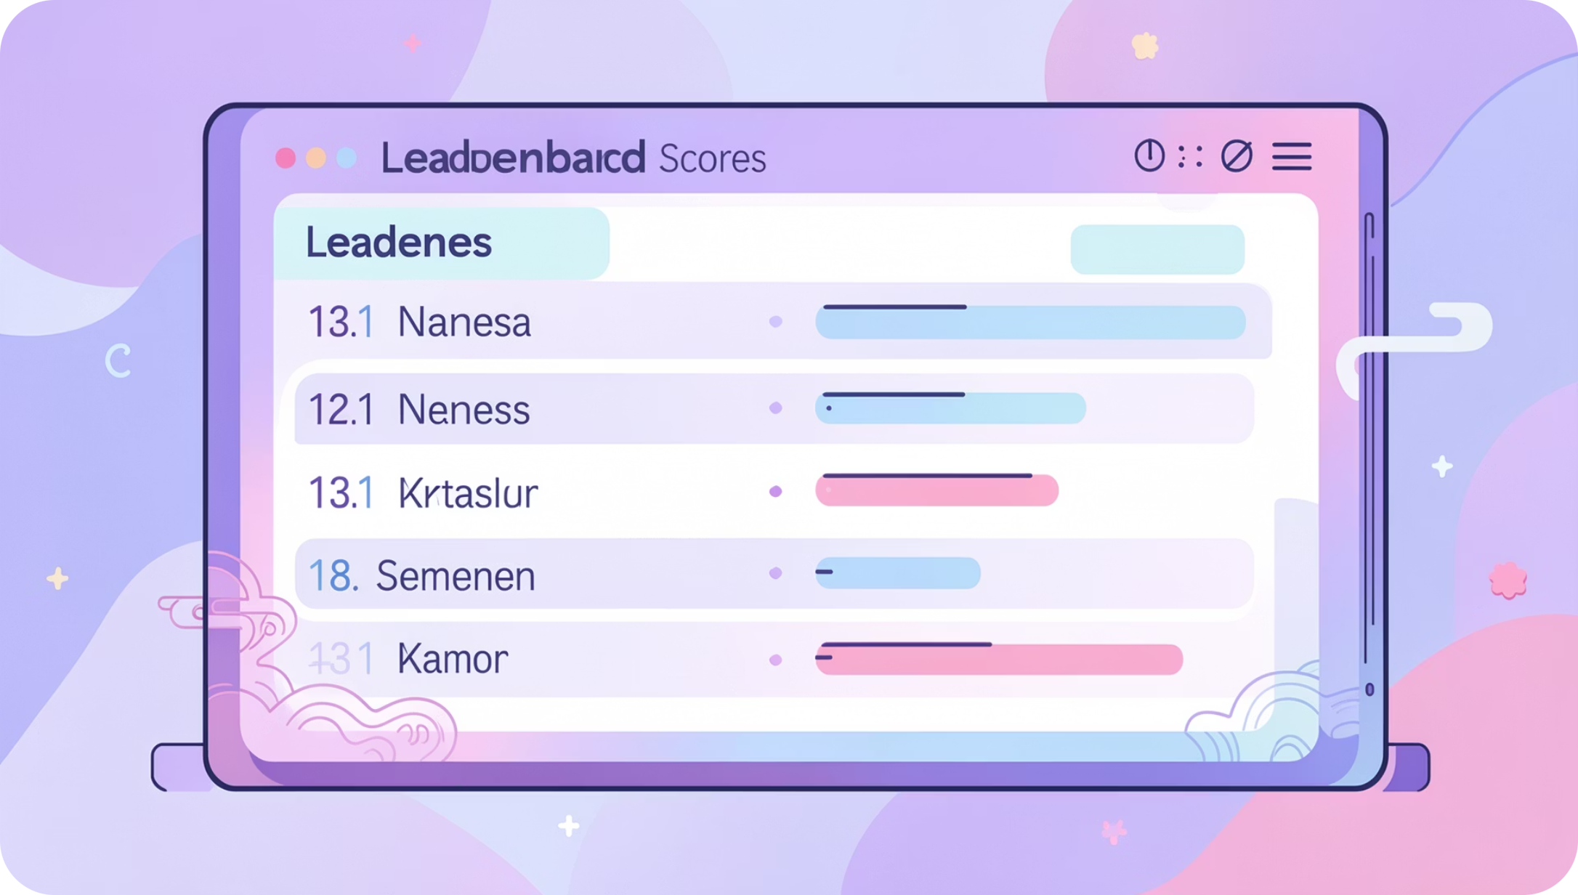

Reading the Scoreboard
viewScoreboard() Logic
The function opens scores.txt in read mode and uses a while loop with fscanf to parse each line until EOF.
Each record in the file stores one player per line: PlayerName Attempts
Error Handling
If the file doesn't exist yet (fp == NULL), the function prints "No scores available yet" and returns gracefully — no crash.

Slide 9
Key C Concepts Used
Random Numbers
do-while Loop
srand() + rand() from <stdlib.h> and <time.h> for non-repeating sequences each run.
Guarantees at least one guess is made before checking the exit condition — ideal for input loops.
File I/O
Modular Functions
fopen, fprintf, fscanf, fclose for persistent read/write operations on text files.
Separating logic into main(), playGame(), and viewScoreboard() improves readability and reuse.

Slide 10

Summary & Next Steps
What You Built
Extend It
A fully functional C console game with 3 modules, random number logic, attempt tracking, and persistent file-based scoreboard.
Sort the scoreboard by fewest attempts, add difficulty levels (range 1–50 vs 1–500), or display a top-3 leaderboard.
Key Takeaway
File I/O with fopen/fprintf/fscanf is the foundation of persistence in C — master it and you can store any game data.

